Slide 1
Machine-Learning-Augmented Chemisorption Model for CO₂ Electroreduction Catalyst Screening Paper Replication
BY Aadit Patel

Slide 2
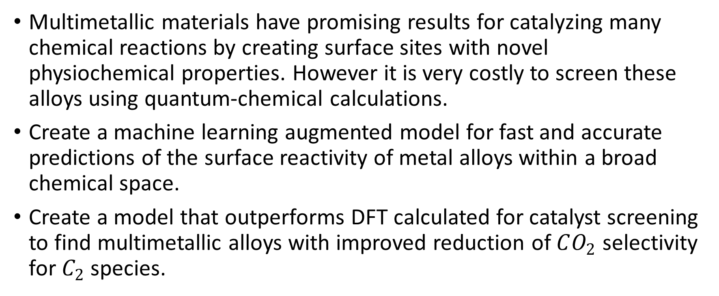
Purpose
Multimetallic materials have promising results for catalyzing many chemical reactions by creating surface sites with novel physiochemical properties. However it is very costly to screen these alloys using quantum-chemical calculations.
Create a machine learning augmented model for fast and accurate predictions of the surface reactivity of metal alloys within a broad chemical space.
Create a model that outperforms DFT calculated for catalyst screening to find multimetallic alloys with improved reduction of $CO_{2}$ selectivity for $C_{2}$ species.

Slide 3
Why Machine Learning?
D-band theory of chemisorption provides insight into the characteristics of optimal catalysts and offers a basis for screening
However, only a subset of alloy materials with small perturbations to the host metal can be observed in this way due to the tight-binding approximations employed in this theory.
A machine learning model would be able to capture nonlinear complex adsorbate-substrate interactions allowing for large scale screening of reactivity descriptors in the alloy material space.

Slide 4
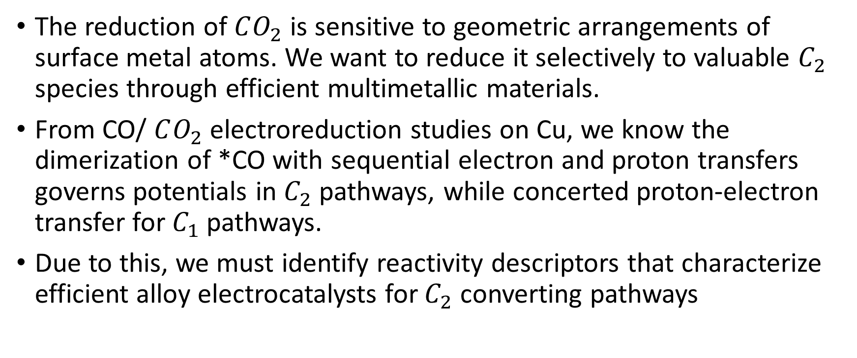
Electroreduction goals
The reduction of $CO_{2}$ is sensitive to geometric arrangements of surface metal atoms. We want to reduce it selectively to valuable $C_{2}$ species through efficient multimetallic materials.
From CO/ $CO_{2}$ electroreduction studies on Cu, we know the dimerization of *CO with sequential electron and proton transfers governs potentials in $C_{2}$ pathways, while concerted proton-electron transfer for $C_{1}$ pathways.
Due to this, we must identify reactivity descriptors that characterize efficient alloy electrocatalysts for $C_{2}$ converting pathways

Slide 5
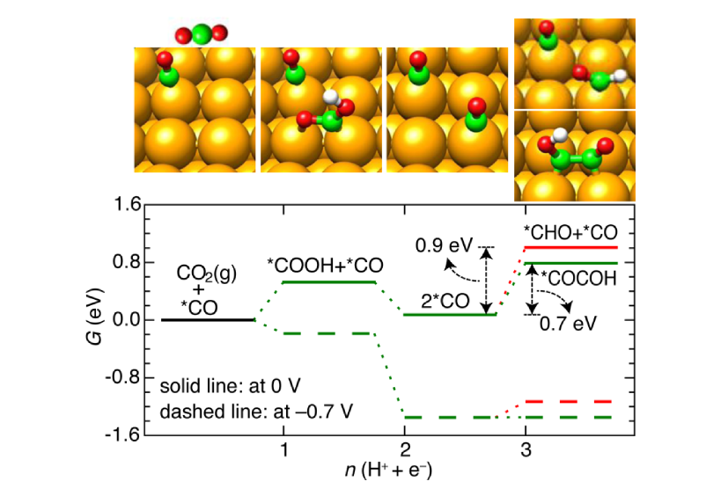

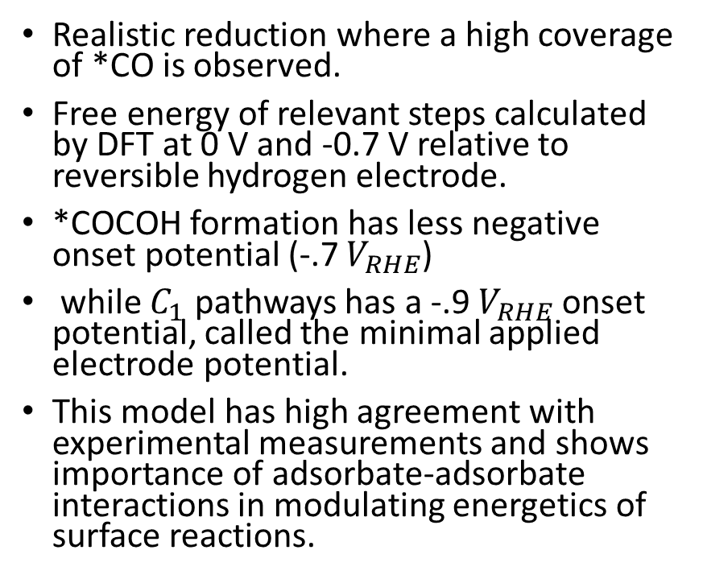
Free energy pathways for $C_{1}$ and $C_{2}$ for electroreduction on Cu(100)
Figure 1
Realistic reduction where a high coverage of *CO is observed.
Free energy of relevant steps calculated by DFT at 0 V and -0.7 V relative to reversible hydrogen electrode.
*COCOH formation has less negative onset potential (-.7 $V_{RHE}$)
while $C_{1}$ pathways has a -.9 $V_{RHE}$ onset potential, called the minimal applied electrode potential.
This model has high agreement with experimental measurements and shows importance of adsorbate-adsorbate interactions in modulating energetics of surface reactions.

Slide 6
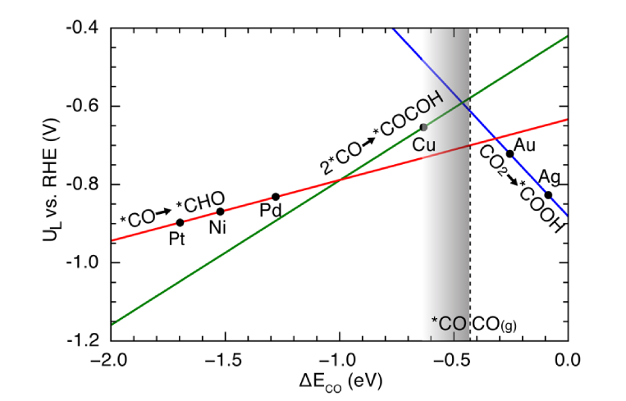
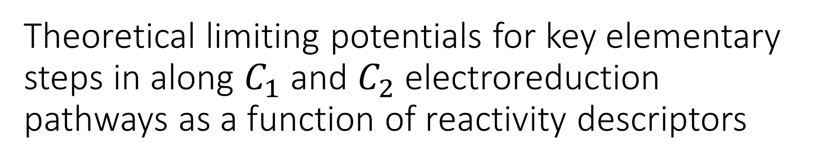
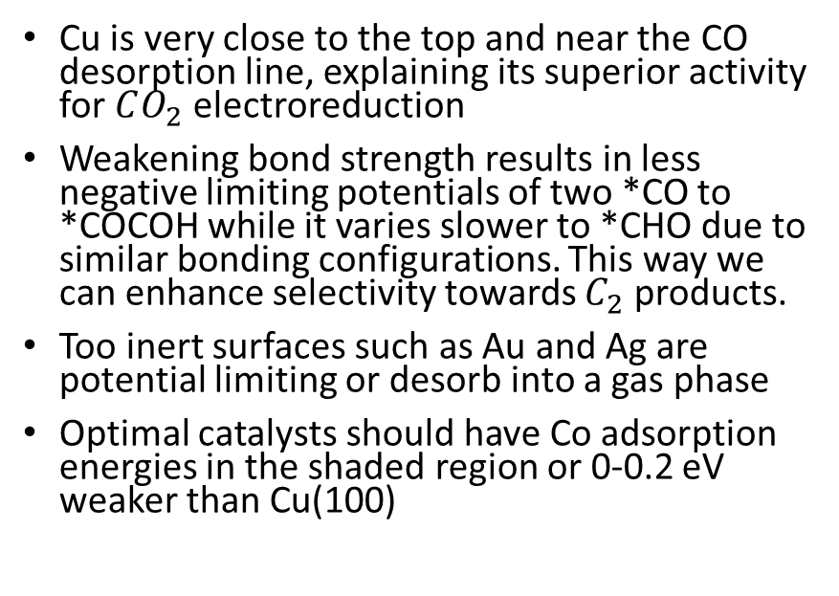
Theoretical limiting potentials for key elementary steps in along $C_{1}$ and $C_{2}$ electroreduction pathways as a function of reactivity descriptors
Figure 2
Cu is very close to the top and near the CO desorption line, explaining its superior activity for $CO_{2}$ electroreduction
Weakening bond strength results in less negative limiting potentials of two *CO to *COCOH while it varies slower to *CHO due to similar bonding configurations. This way we can enhance selectivity towards $C_{2}$ products.
Too inert surfaces such as Au and Ag are potential limiting or desorb into a gas phase
Optimal catalysts should have Co adsorption energies in the shaded region or 0-0.2 eV weaker than Cu(100)

Slide 7
How to explore the infinite chemical space for alloys with desired properties
Much effort has gone to creating a model relating surface reactivity of a metal site to its electronic properties. D-band theory has been widely used to understand variations in adsorption energies on metals and their alloys.
Studies have shown d-band model predicts surface reactivity of transition metals and a few alloy materials reasonably well.
However developing a comprehensive chemisorption model for a broad chemical space has shows a large deviation of predicted CO adsorption energies

Slide 8
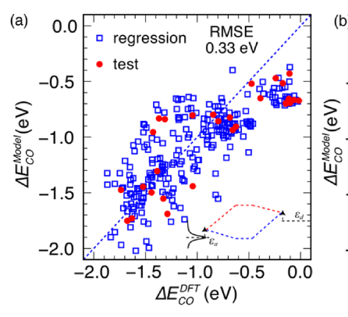
D-band theory two-level interaction model vs DFT calculations
Figure 3a
This model takes into account hybridization of metal d-states with two renormalized resonance orbitals of *CO (5σ and 2π*), extracted from density of states of CO adsorbed on Al(100).
The average RMSE of this model predictions was ~0.3 eV. This error is larger than the window we are looking for from figure 2 (0-0.2 eV)

Slide 9
Machine Learning Model
With an ever-growing database of material properties, a machine learning model can be used to map the complex physical interactions to statistical models.
Numerical representation of each variable is very important to creating a ML model. Thus we properties of the d-states distribution including filling (zeroth moment up to the fermi level), center (first moment relative to the Fermi level), width (square root of the second central moment), skewness (third standardized moment), and kurtosis (fourth standardized moment), and the local Pauling electronegativity.
Host metal dependent physical constants such as spatial extent of metal d-orbitals, adsorbate-metal interatomic d coupling matrix element squared, work function, atomic radius, ionization potential, electron affinity, and Pauling electronegativity are also included as secondary features. This helps us better understand trends for bonding across a series of metal surfaces.

Slide 10
Model Creation
A feedforward artificial neural network model was created to construct a nonlinear mapping of fingerprint vectors and an output target of CO adsorption energy.
A sigmoid activation function was used to process all the inputs into the neurons of the hidden layers in the network, while a linear function was used for the output layer.
A gradient descent optimization algorithm was used to train the network on the training data.
All the input features were standardized to improve to improve the performance of the network
A 10-fold cross validation with repeated randomization of data was used to determine the network’s structure and evaluating its performance.

Slide 11
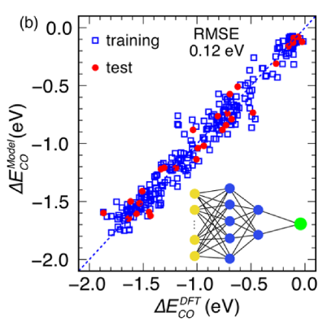
Artificial Neural Network Results
Figure 3b
The optimal network configuration was found to be 2 hidden layers with 5 and 2 neurons respectively.
The ANN had the best RMSE of ~.1 eV making it a promising model.
The RMSE of this model is smaller than the window of 0.2eV that we are searching for and thus can be used to more accurately screen for other catalysts.

Slide 12
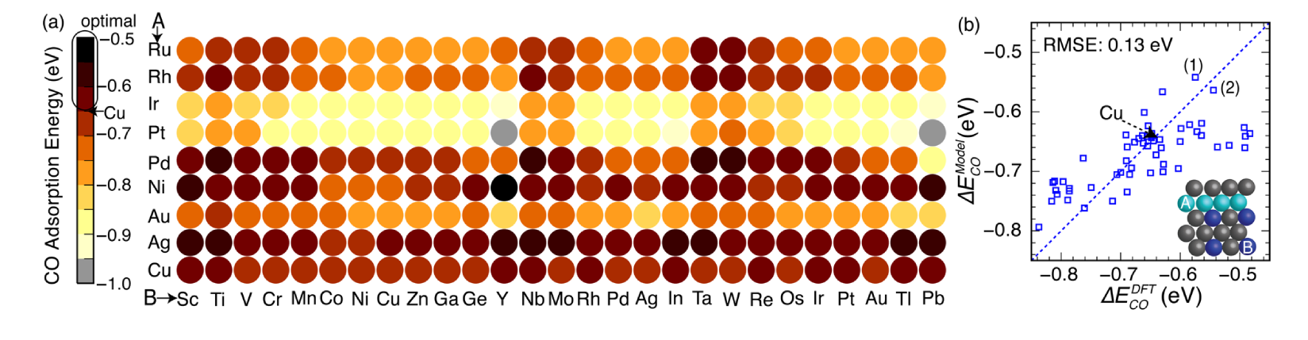
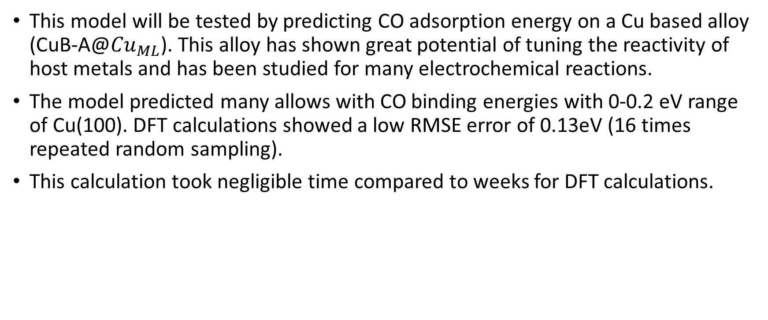
Testing ANN model
This model will be tested by predicting CO adsorption energy on a Cu based alloy (CuB-A@${Cu}_{ML}$). This alloy has shown great potential of tuning the reactivity of host metals and has been studied for many electrochemical reactions.
The model predicted many allows with CO binding energies with 0-0.2 eV range of Cu(100). DFT calculations showed a low RMSE error of 0.13eV (16 times repeated random sampling).
This calculation took negligible time compared to weeks for DFT calculations.
Figure 4

Slide 13
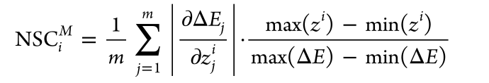
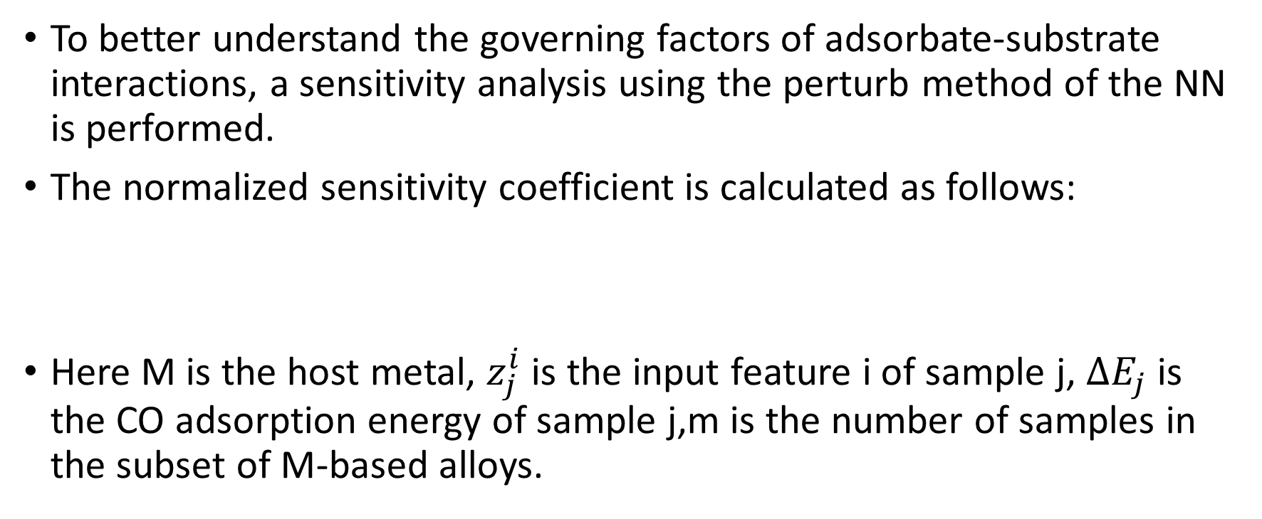
Sensitivity analysis
To better understand the governing factors of adsorbate-substrate interactions, a sensitivity analysis using the perturb method of the NN is performed.
The normalized sensitivity coefficient is calculated as follows:
Here M is the host metal, $z_{j}^{i}$ is the input feature i of sample j, ${ΔE}_{j}$ is the CO adsorption energy of sample j,m is the number of samples in the subset of M-based alloys.

Slide 14
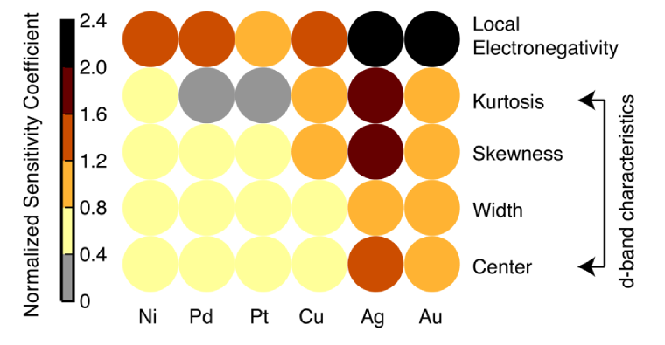
Normalized Sensitivity Coefficients
The d-band center plays an important role as suggested by d-band theory.
D-band states with higher moments of the d-state distribution has a significant impact on Cu, Ag, and Au.
Local Pauli electronegativity dictating the absorbate-metal bonding distance plays a much more important role in chemical bonding than previously thought.
This sensitivity analysis should not undermine the importance of the d-band center however as this feature can be changed through strain and ligand engineering, while other features are not as easy to change.

Slide 15
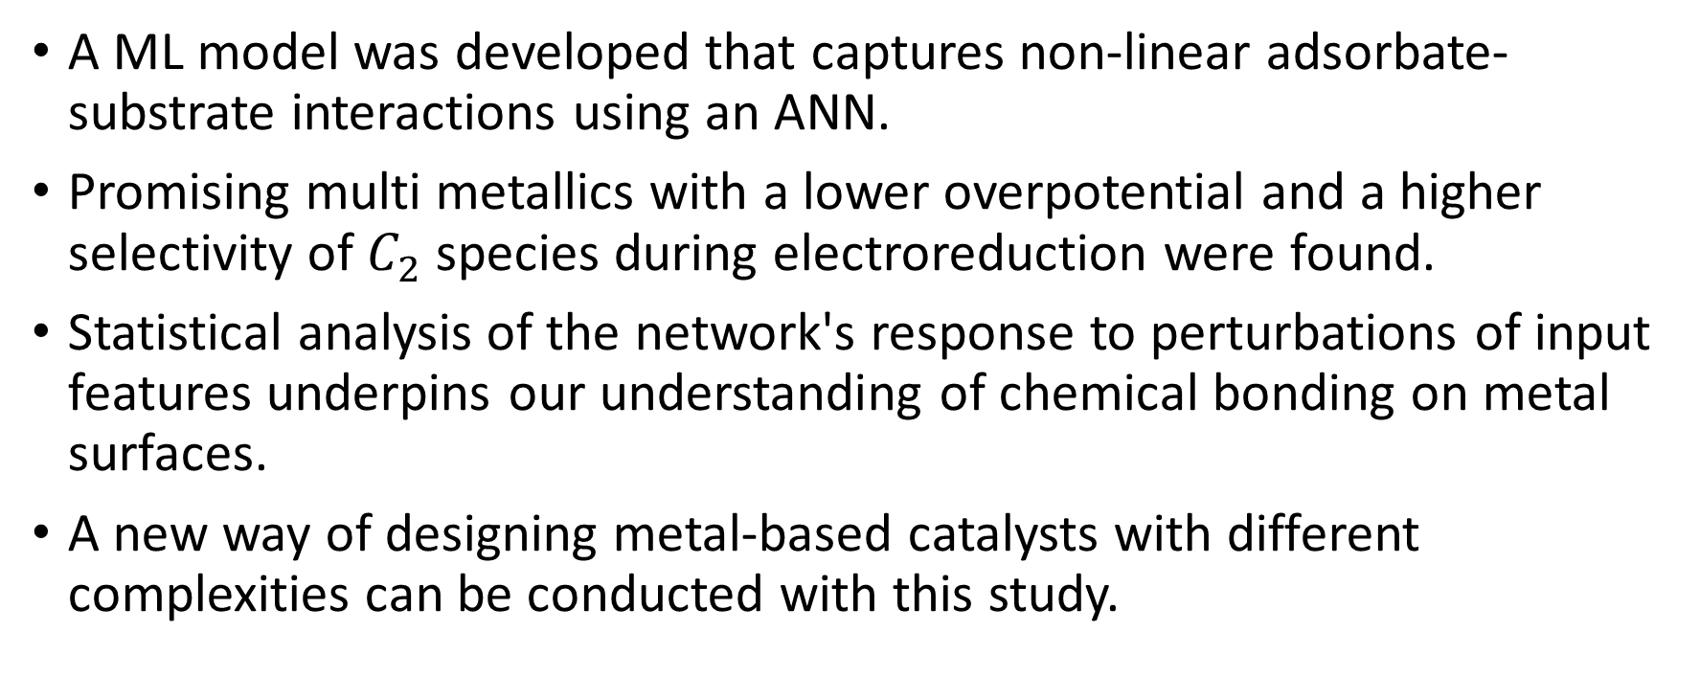
Conclusion of paper
A ML model was developed that captures non-linear adsorbate-substrate interactions using an ANN.
Promising multi metallics with a lower overpotential and a higher selectivity of $C_{2}$ species during electroreduction were found.
Statistical analysis of the network's response to perturbations of input features underpins our understanding of chemical bonding on metal surfaces.
A new way of designing metal-based catalysts with different complexities can be conducted with this study.

Slide 16
Replicating the ML model
There were a few main goals I had when creating my own ML model using the supporting data from this paper.
Test multiple different types of ML models and see which is the most efficient
See if I can create a model that had a lower RMSE error than then ANN from the paper
Do a correlation analysis to see which inputs are most important in determining the CO adsorption energies.
The supporting page to this paper consists of all the data necessary to make this model. The first task was to place this data into a ML friendly csv file.

Slide 17
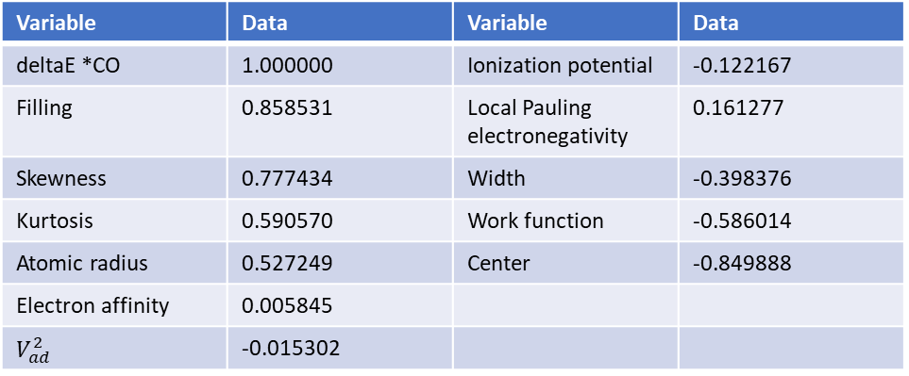
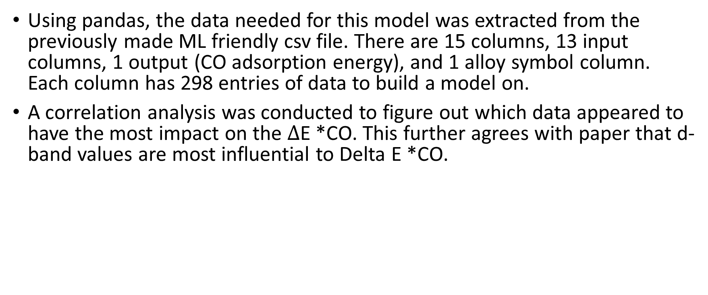
Data analysis
Using pandas, the data needed for this model was extracted from the previously made ML friendly csv file. There are 15 columns, 13 input columns, 1 output (CO adsorption energy), and 1 alloy symbol column. Each column has 298 entries of data to build a model on.
A correlation analysis was conducted to figure out which data appeared to have the most impact on the $Δ$E *CO. This further agrees with paper that d-band values are most influential to Delta E *CO.
Variable | Data | Variable | Data
deltaE *CO | 1.000000 | Ionization potential | -0.122167
Filling | 0.858531 | Local Pauling electronegativity | 0.161277
Skewness | 0.777434 | Width | -0.398376
Kurtosis | 0.590570 | Work function | -0.586014
Atomic radius | 0.527249 | Center | -0.849888
Electron affinity | 0.005845
$$V_{ad}^{2}$$ | -0.015302

Slide 18
Data setup
The data was split into 80% for training and 20% as the test set. The input and output variables were also split from the main data.
A standard scaler was applied to the data to make it easier for the ML model to learn from.
Three different models will be built and tested using the training data. A linear regressor model, a decision tree model, and a random forest regressor.
The models were created and fitted to the data. Next the models will be used to predict the outputs of the training data to find the RMSE. A 10-fold cross validation will also be conducted to check if the models are overfitted to the training data.

Slide 19
Model predictions on training data
Linear regression:
RMSE: 0.1453
Cross Validation score: 0.1529
This simple linear regression model had a surprisingly good score that is very close too the ANN from the paper with no overfitting.
Decision tree regressor:
RMSE: 0.00
Cross Validation score: 0.1460
The decision tree regressor is horribly overfit to the training data as seen by the RMSE vs cross val score comparison. This model also had very similar results to the simpler linear regressor and thus will be abandoned.
Random forest regressor:
RMSE: 0.0406
Cross Validation score: 0.1143
The Random Forest regressor is also very overfit too the data, however it had the best cross val score which is even better than the RMSE of the ANN from the paper.

Slide 20
Model results on test set
The prepared models were finally put to the test by predicting the output values of the test set and a rmse score was found.
Linear regression model RMSE: 0.1472
Random Forest Regressor model RMSE: 0.0996
The linear regressor was slightly worse than the ANN rmse score but it is still surprising that the results were this close. This may indicate that the ANN is not picking up as many non-linear patterns in the input data as the paper indicates.
The Random forest regressor actually produced better results than the ANN created in the paper.

Slide 21
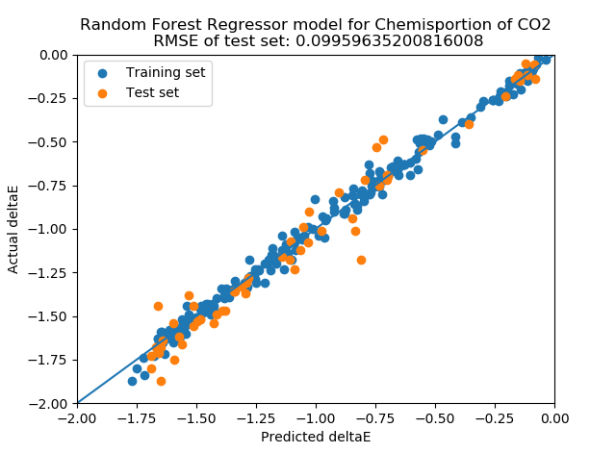
Random forest data
The RMSE of the random forest data was around .09-.11 depending on the random state, but still slightly better than the ANN results from the paper.
This may be due to a different machine learning library being used as the paper used the out of date pybrain library, while I used the more updated and widely used scikit-learn library.
A repeat trial of the ANN will have to be conducted using tensorflow, a newer, bigger, and more commonly used library than pybrain. It will be interesting to see if the ANN can produce better results than those of the random forest algorithm.

